Slide 1
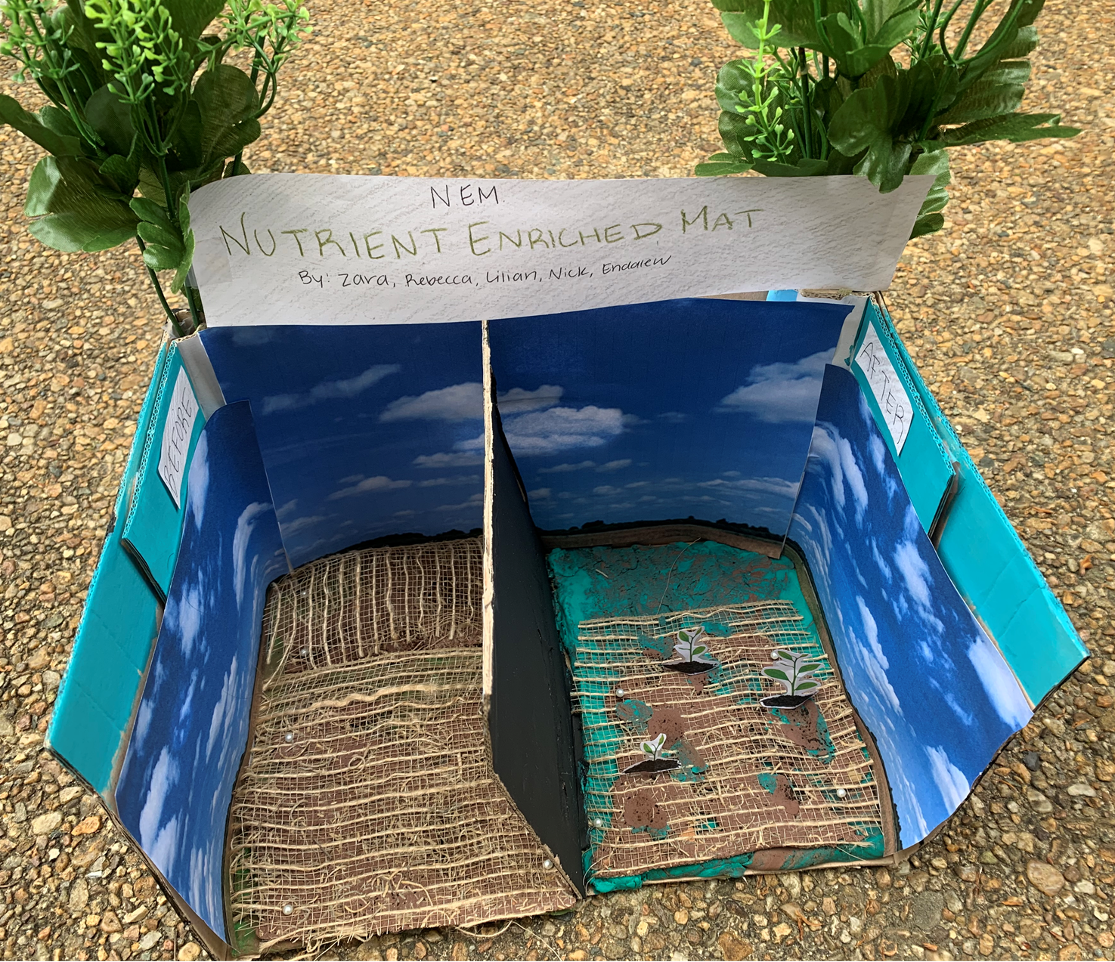
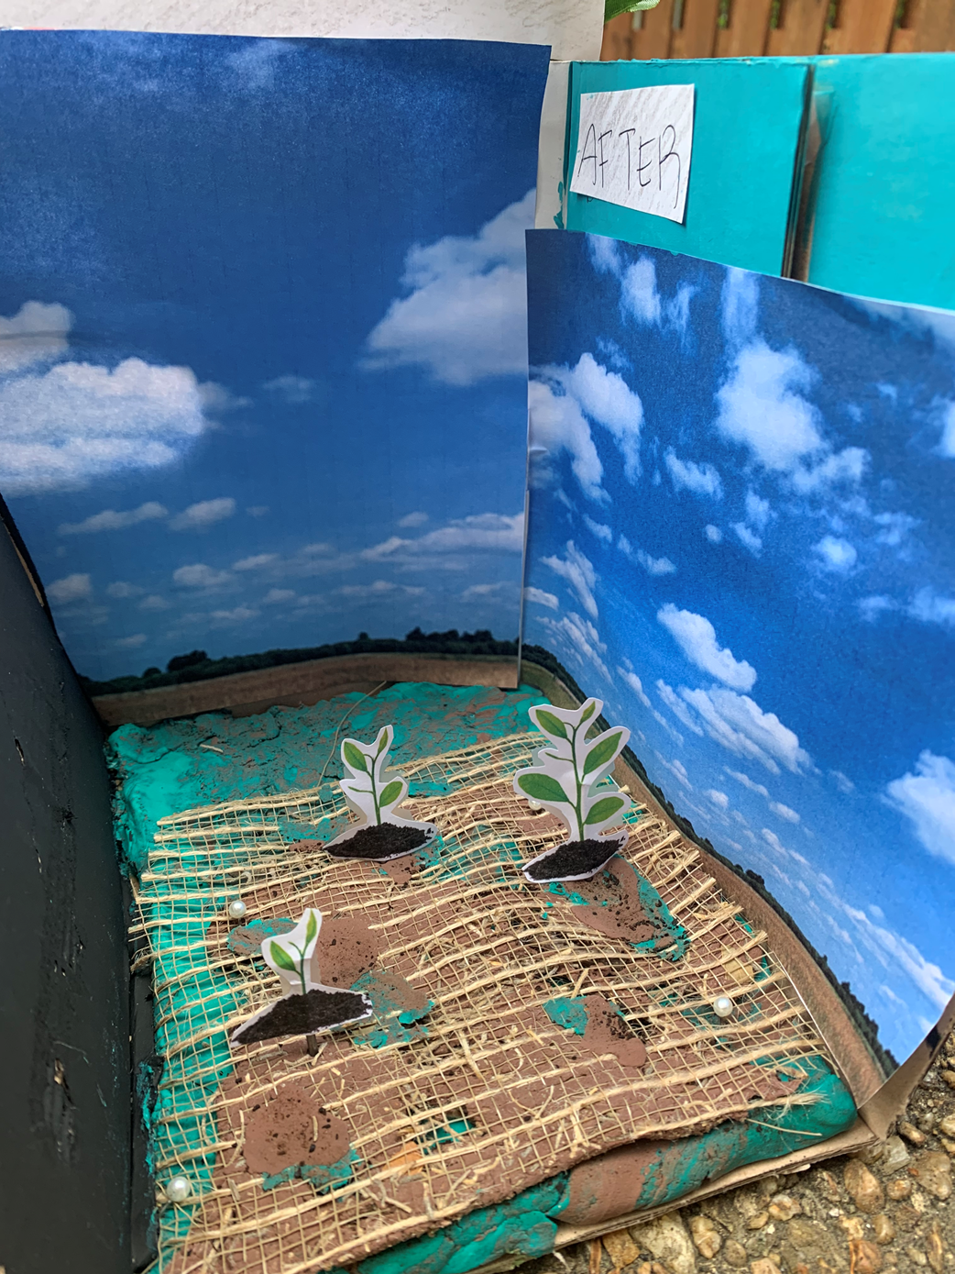
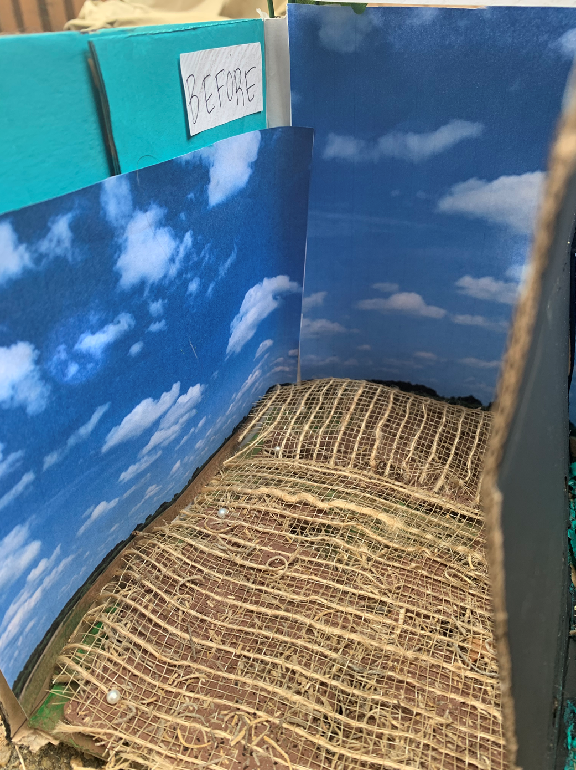
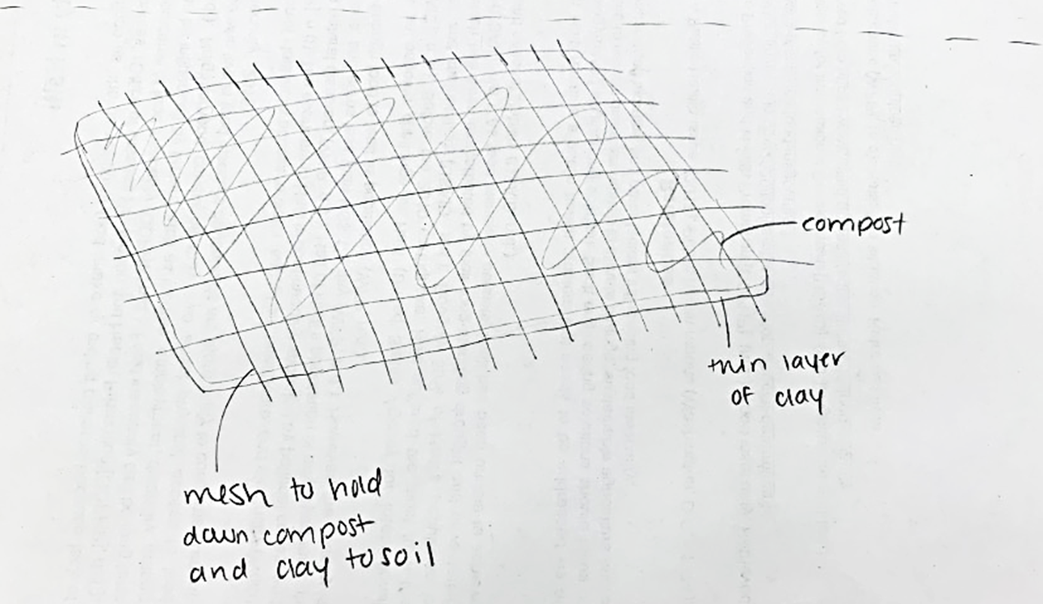
FOOD INSECURITY IN HAITI
Rebecca Flores, Zara Dilic, Endalew Asefa, Nick Piscitelli, Lilian Alverenga
Global Community Health 205-004 | George Mason University
WHAT DOES FOOD INSECURITY MEAN?
Food insecurity is the result of a lack of food available to sustain a nation’s population. The issue of food insecurity in Haiti has resulted in many of its people experiencing hunger (United States Agency for International Development [USAID], n.d.). We focused on one specific problem that impacts food insecurity and created an engineering-based solution.
OUR PROBLEM: SOIL DEGRATION
Agricultural soil degradation due to poor farming practices, deforestation, extreme weather, and natural disasters has led to a reduction in agricultural production and crop yield. Many small-scale farmers do not use agricultural practices that prevent the depletion of nutrients and minerals in the soil and the disappearance of the topsoil. The lack of fertilizer used, and no crop rotation has led to the reduction of suitable land for agriculture in Haiti (Barguot & Raizada, 2013).
DECISION MATRIX ON POSSIBLE SOLUTIONS
HAITI AND IT’S PEOPLE
Haiti is located on the island of Hispaniola in the Caribbean Sea. The geography of Haiti is characterized by rocky shores, limited plain regions, mountain ranges, short rivers, plateaus, and an interior basin (Haiti, n.d.). The climate in Haiti is warm and humid, and it is the second nation to experience the most natural disasters throughout the year (Haiti, n.d.). Haiti’s population currently stands at around 11 million people, with a median age of 23. Most of the Haitian population occupy the urban areas over the rural areas (Worldometer, n.d.). Although urbanization in Haiti has seen an increase, around two-fifths of the population still live in rural areas and depended on the crop production of small subsistence farmers. Many of these farms are located on the plain and valley regions even though most of the land is being over-cultivated there (Haiti, n.d.).
OUR SOLUTION: N.E.M.
In order to create this mat, resources found in the area will be used. Clay soil, lalo (jute) plant, and biodegradable waste provided by SOIL, are all resources easily attainable and come at a low cost (Haiti, n.d.). SOIL is an organization familiar to the area, who will be partnering with the NEM team (SOIL, n.d.). They will provide compost that will be the main source of nutrients that will be implemented into the soil. Using the lalo (jute) plant, a mesh like material will be created in order to hold the compost and clay soil. A layer of lalo will be placed above and below the compost material to allow for adequate binding (North American Green, n.d.). A solar powered compressor will press all the materials together, making a long sheet. Thus, creating the nutrient enriched mat, N.E.M..
PICTURES OF N .E.M. PROTOTYPE
SOIL
For our solution, our group is planning to partner with SOIL. They are a program based in Haiti who uses ecological sanitation (EcoSan) to use waste from the people of Haiti for agricultural use. The waste is treated and turned into fertile compost. By doing it this way, waterborne diseases have declined and also it gives a way to increase nutrients in the soil. We plan to use the compost they make into our nutrient enriched mat. This way, the unique idea we have combine with the existing compost from SOIL to make our idea more practical (SOIL, n.d.)
BACKGROUND STATISTICS
Over half the population lives on less than $1 a day ([WFP], n.d.)
Around 40% of Haitian households are under or malnourished ([USAID}, n.d.)
22% of Haitian children are malnourished ([WFP], n.d.)
Farms are on average are less than 1 hectare ([WFP], n.d.)
Over 50% of food and resources are imported per year ([WFP], n.d.)
Less than 2% of the Haiti’s natural forest-cover remains (Araujo, 2013)
REFERENCES:
Araujo, S. (2013). Investing in Haiti’s Rural Community. Reliefweb. Retrieved from: https://reliefweb.int/report/haiti/investing-haiti%E2%80%99s-rural-community
Bargout, R. N., & Raizada, M. N. (2013). Soil nutrient management in Haiti, pre-Columbus to the present day: lessons for future agricultural interventions. Agriculture & Food Security, 2(11), 1-20. https://doi.org/10.1186/2048-7010-2-11
Haiti. (n.d.). In Encyclopædia Britannica online. Retrieved from: https://www.britannica.com/place/Haiti/Agriculture-forestry-and-fishing
North American Green. (n.d.). Biodegradable Erosion Control Blankets. Retrieved from: https://nagreen.com/Systems-and-products/RollMax/BioNet
SOIL. (n.d.). About Soil. Retrieved from: https://www.oursoil.org/who-we-are/about-soil/
United States Agency for International Development [USAID]. (n.d.). Agriculture and food security. Retrieved from: https://www.usaid.gov/haiti/agriculture-and-food-security
Worldometers. (n.d.). Haiti Population. Retrieved April 7, 2019, from: http://www.worldometers.info/world-population/haiti-population/
World Food Programme [WFP]. (n.d.). Haiti: The situation. Retrieved from: https://www1.wfp.org/countries/haiti
SKETCH OF N.E.M. (Nutrient Enriched Mat)

